Slide 1
게임엔진2 제3주
XR 소개 및 블럭쌓기
드론IoT시뮬레이션학부
담당교수 : 이형원
E304호, hwlee@inje.ac.kr

Slide 2
Oculus 사용
Oculus Link를 사용하여 직접 PC에 연결
Meta Quest 2 또는 Meta Quest에 Oculus Link 사용하기 | Meta 스토어 (facebook.com)
Graphic card NVIDIA GTX1065Super 이상, RTX20 또는 RTX30 시리즈
Build settings 에서 Target을 Windows로 하고 Unity Editor에서 실행하면 바로 PC화면과 연결된 Oculus에서 실행이 됨.
실행파일을 빌드한 후 *.exe 파일을 실행해도 연결된 Oculus에서 실행이 가능함.
PC에 Oculus 앱 설치하기 | Meta 스토어 (facebook.com)

Slide 3
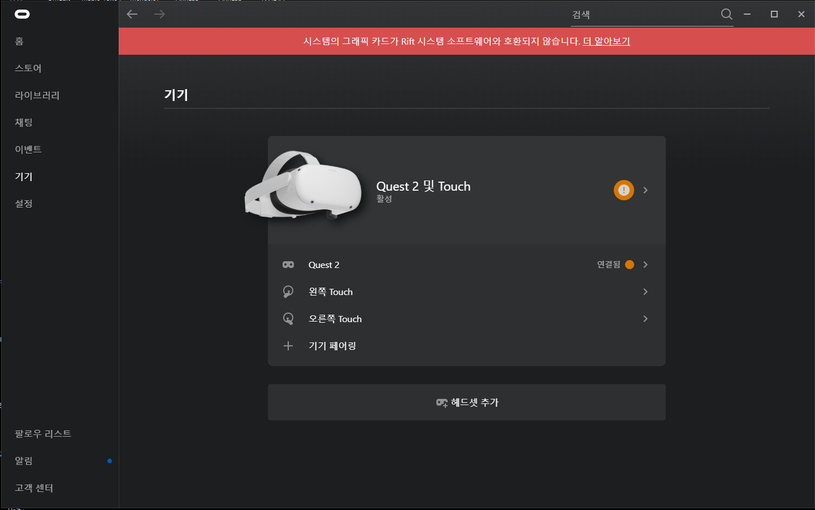

Slide 4
Oculus 사용
Oculus Link를 사용할 수 없는 경우
Graphic card 가 지원하지 않는 경우
Build settings 에서 Target을 Android로 하고 Build and Run을 실행하면 생성된 *.apk 파일이 개발자 모드로 연결된 Oculus에 다운로드되어 실행이 됨.
다운로드된 앱은 이 후에 Oculus 단독으로도 실행이 가능함.

Slide 5
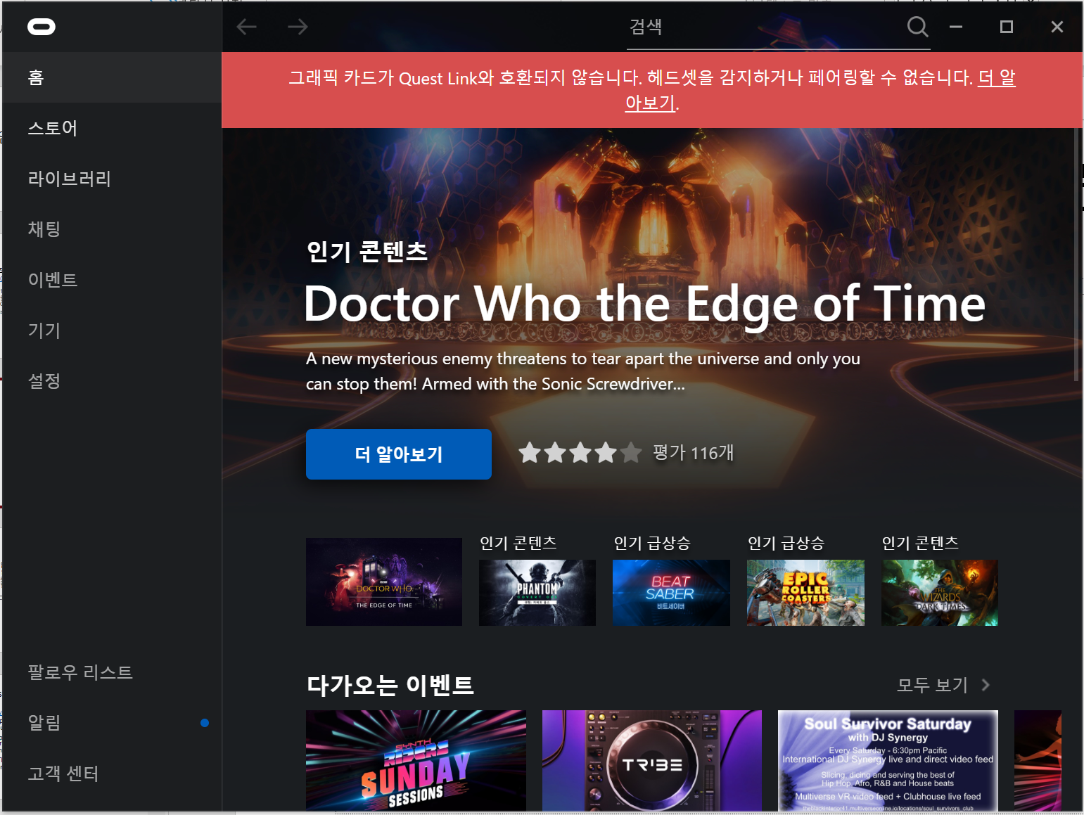

Slide 6
XR(VR/AR) Basics
Unity - Manual: XR (unity3d.com)
VR(Virtual Reality): The application simulates a completely different environment around the user.
MR(Mixed Reality): The application combines its own environment with the user’s real-world environment and allows them to interact with each other.
AR(Augmented Reality): The application layers content over a digital view of the real world.

Slide 7
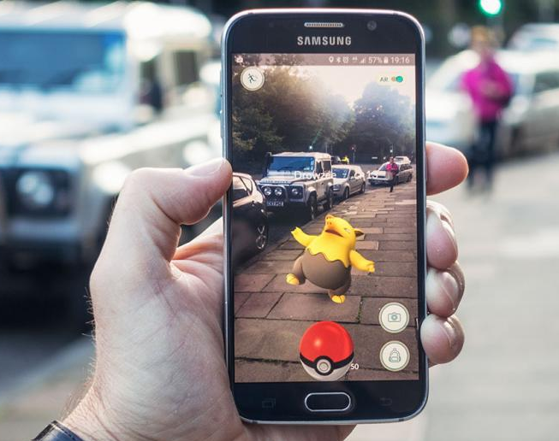
VR, MR, AR and XR
WHAT’S THE DIFFERENCE BETWEEN AR, VR, AND MR?
Augmented reality (AR) adds digital elements to a live view often by using the camera on a smartphone. Examples of augmented reality experiences include Snapchat lenses and the game Pokemon Go.
Virtual reality (VR) implies a complete immersion experience that shuts out the physical world. Using VR devices such as HTC Vive, Oculus Rift or Google Cardboard, users can be transported into a number of real-world and imagined environments such as the middle of a squawking penguin colony or even the back of a dragon.
In a Mixed Reality (MR) experience, which combines elements of both AR and VR, real-world and digital objects interact. Mixed reality technology is just now starting to take off with Microsoft’s HoloLens one of the most notable early mixed reality apparatuses.
Extended Reality (XR) is an umbrella term that covers all of the various technologies that enhance our senses, whether they’re providing additional information about the actual world or creating totally unreal, simulated worlds for us to experience. It includes Virtual Reality (VR), Augmented Reality (AR) and Mixed Reality (MR) technologies.

Slide 8
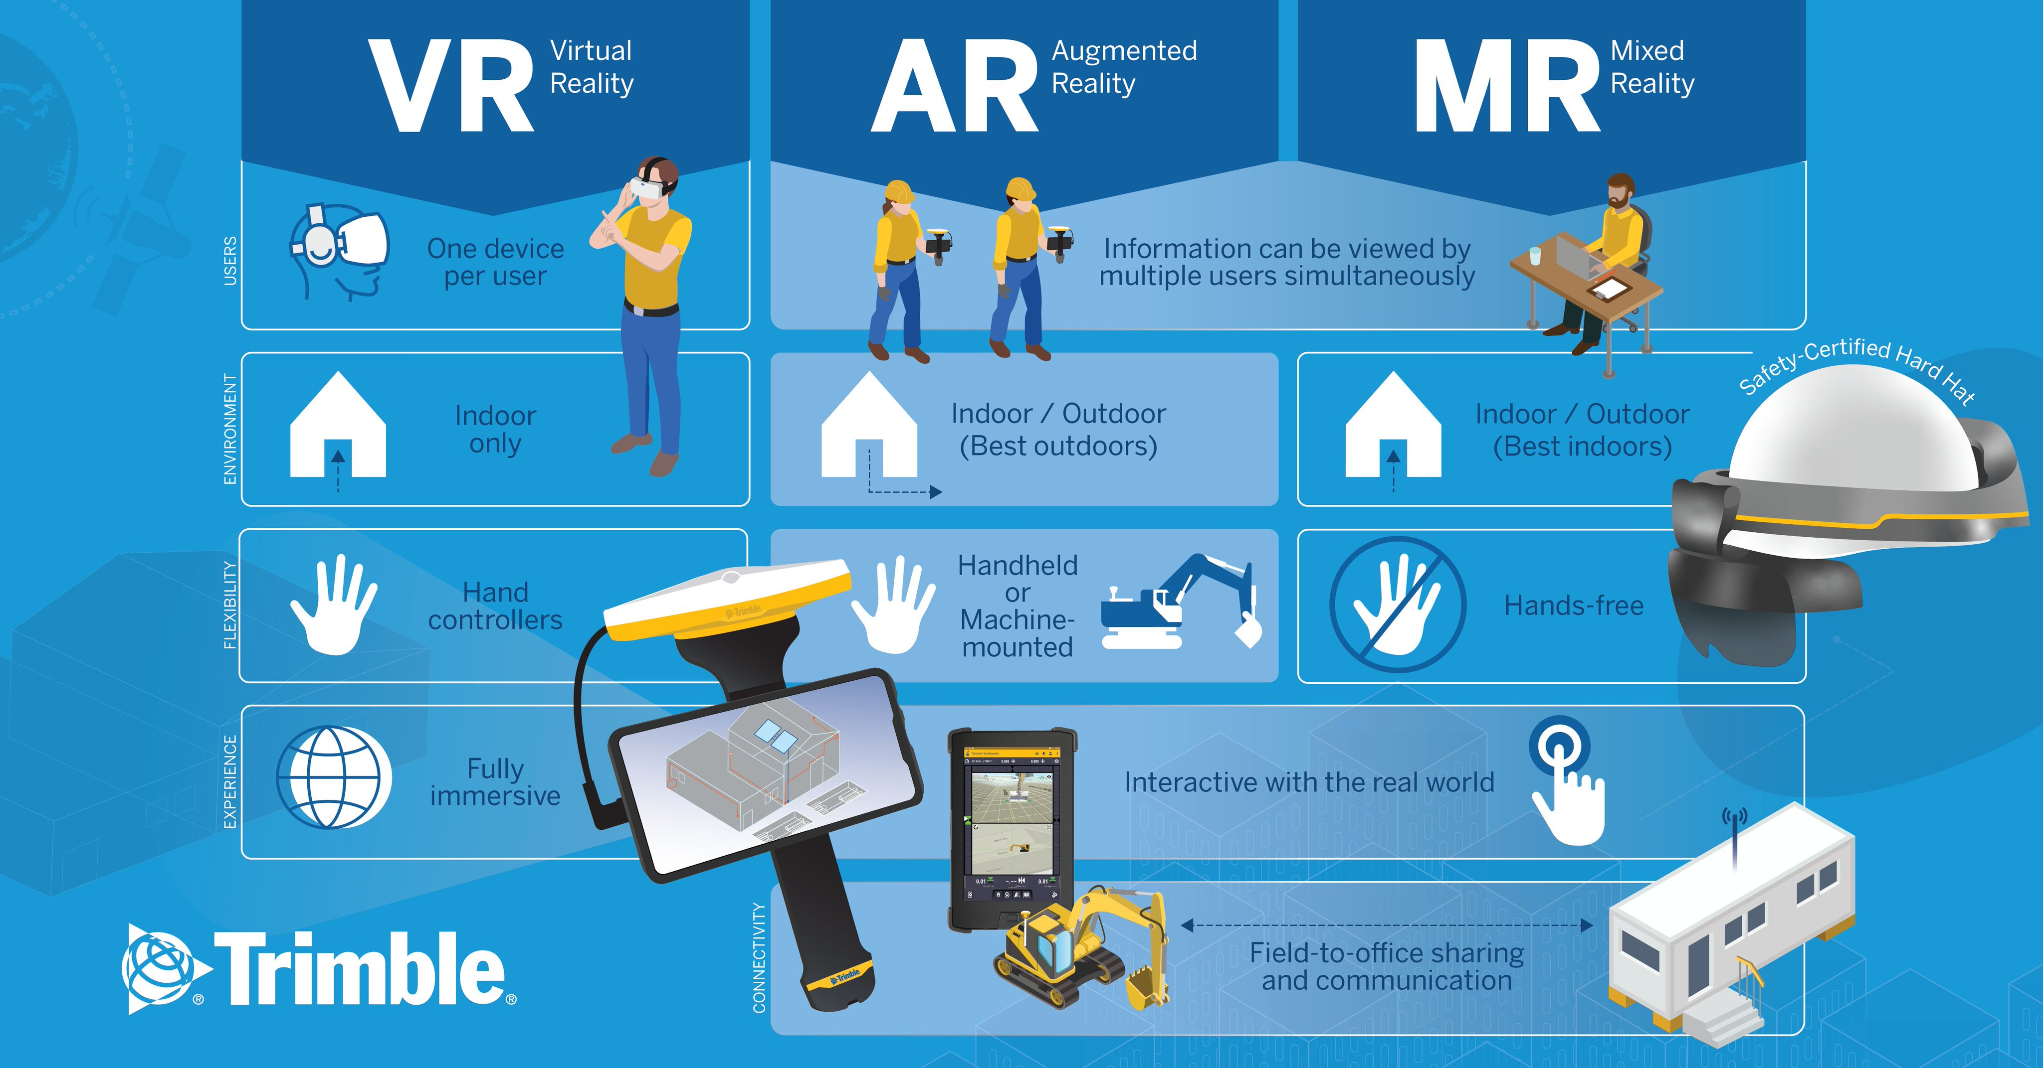

Slide 9
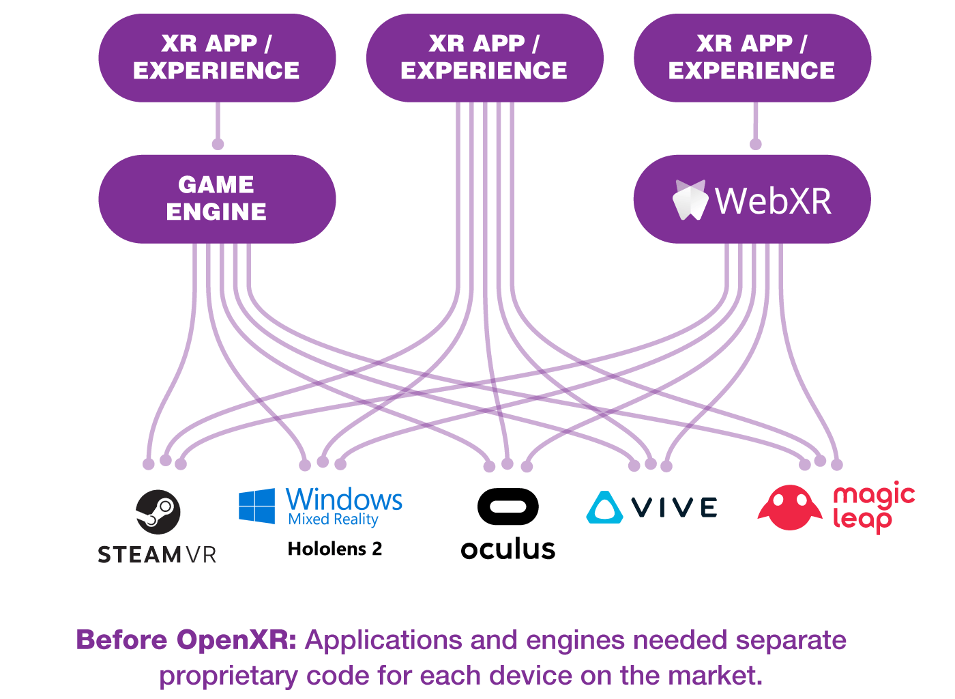

Slide 10
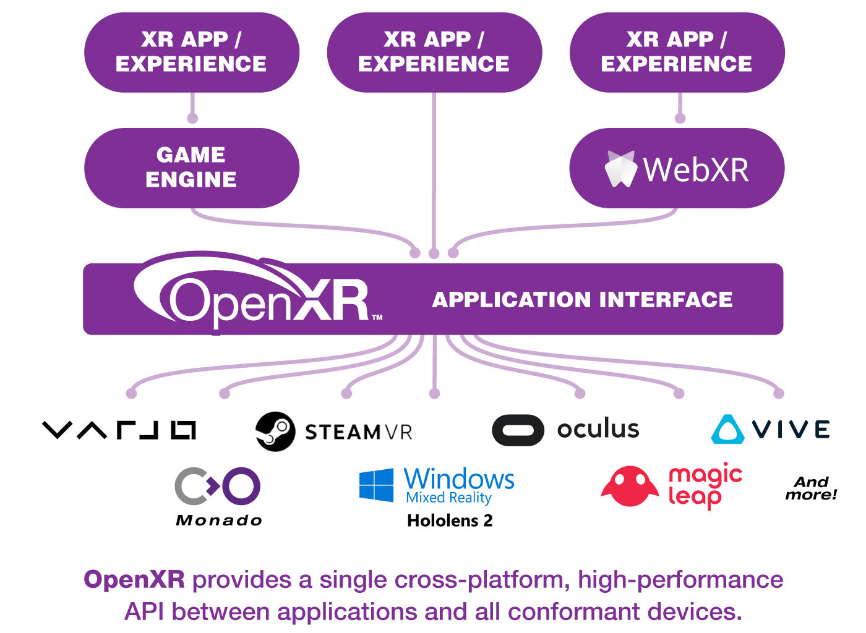

Slide 11
Unity Editor 사용
Unity - Manual: Scene view navigation (unity3d.com)
UnityEditor사용법 (https://injeackr.sharepoint.com/:p:/s/222ASB133101_/EciPWJvzAsNKiU-WfU4-QuMB6uY-3vUmYtVqwiN-qj-_Bg?e=SjGmph )

Slide 12
Supported Platforms
ARKit
ARCore
Microsoft HoloLens
Windows Mixed Reality
Magic Leap
Oculus
OpenXR
PlayStation VR

Slide 13
Unity XR plug-in framework(Unity - Manual: XR (unity3d.com))
Unity has developed a new plug-in framework called XR SDK that enables XR providers to integrate with the Unity engine and make full use of its features. This plug-in based approach improves Unity’s ability to make quick bug fixes, distribute SDK updates from platform partners, and to support new XR devices and runtimes without having to modify the core engine.
How to upgrade to the new framework(https://docs.unity3d.com/Manual/configuring-project-for-xr.html)
How the new framework functions(https://docs.unity3d.com/Manual/XRPluginArchitecture.html)

Slide 14
Configuring your Unity Project for XR (Unity - Manual: Configuring your Unity Project for XR (unity3d.com))
Open the Project Settings window (menu: Edit > Project Settings), and select XR Plug-in Management.
Click Install XR Plug-in Management if the package hasn’t been installed already. You can also install it from the Package Manager window.
After installation completes, select a Plug-in Provider to enable it for the corresponding build target. To do this:
Select a build target (for example, Android).
Select the checkbox to the left of each plug-in you want to use for that build target.
After a plug-in loads, it displays in the left-hand navigation, under XR Plug-in Management. Click the plug-in to configure its settings for each build target.
To set up tracking, from Unity’s main menu, go to GameObject > XR > Add XR Origin(Action-based).

Slide 15
XR Interaction Toolkit(Unity - Manual: XR Interaction Toolkit (unity3d.com))
A high-level, component-based, interaction system for creating VR and AR experiences. It provides a framework that makes 3D and UI interactions available from Unity input events. The core of this system is a set of base Interactor and Interactable components, and an Interaction Manager that ties these two types of components together. It also contains components that you can use for locomotion and drawing visuals.

Slide 16
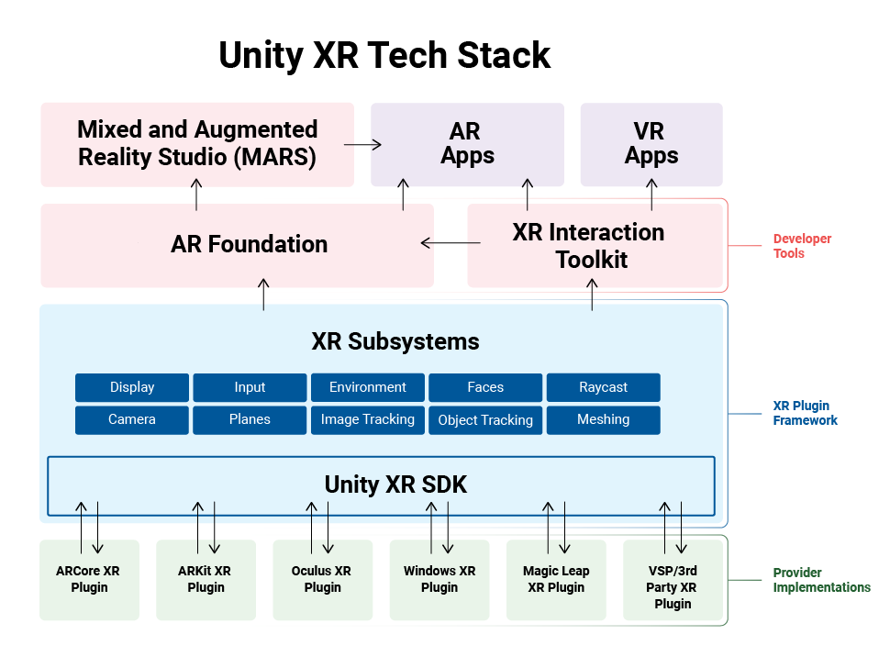
XR Plug-in Framework(Unity - Manual: XR Plug-in Framework (unity3d.com))
Multi-platform developer tools such as AR Foundation and the XR Interaction Toolkit
Faster partner updates from supported plug-ins via the Unity Package Manager
More platforms have access to an interface to leverage Unity’s XR rendering optimizations and developer tools

Slide 17
AR development in Unity
The AR overview page details how to get started with creating an AR application, lists the packages you need to download, and offers related links to additional documentation. Unity recommends downloading the AR Template from the Unity Hub to create your application for Unity’s supported handheld and wearable AR devices.

Slide 18
VR development in Unity
The VR overview page details how to get started creating a VR application, lists the packages you need to download, and offers related links to additional documentation. To start, Unity recommends downloading the VR Template from the Unity Hub to create your application for Unity’s supported VR devices.
Cube잡기만들기(https://injeackr.sharepoint.com/:v:/s/222ASB133101_/EX9v5biv70ZEmE6dSu1bMQUBMfvyx2XMzGmabS2BVqZZdg?e=kmf2Mr)

Slide 19
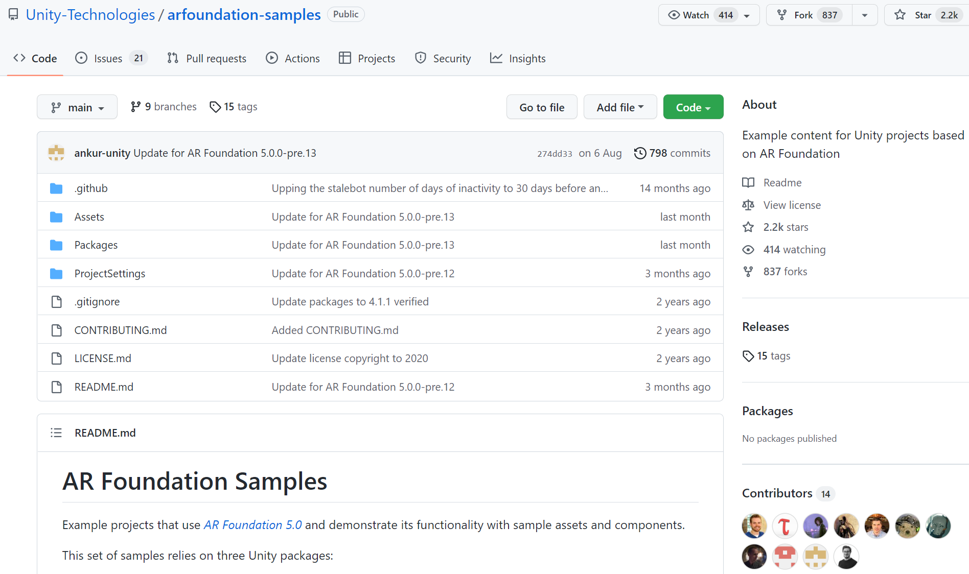
API usage examples
The AR Foundation Samples GitHub repository contains examples of how to use Unity’s AR Foundation APIs.

Slide 20
Additional Unity resources
AR/VR Tutorials on Unity Learn
Unity AR/VR Forums
XR Platform System Requirements
Glossary of XR-specific terms
Rendering for AR/VR

Slide 21
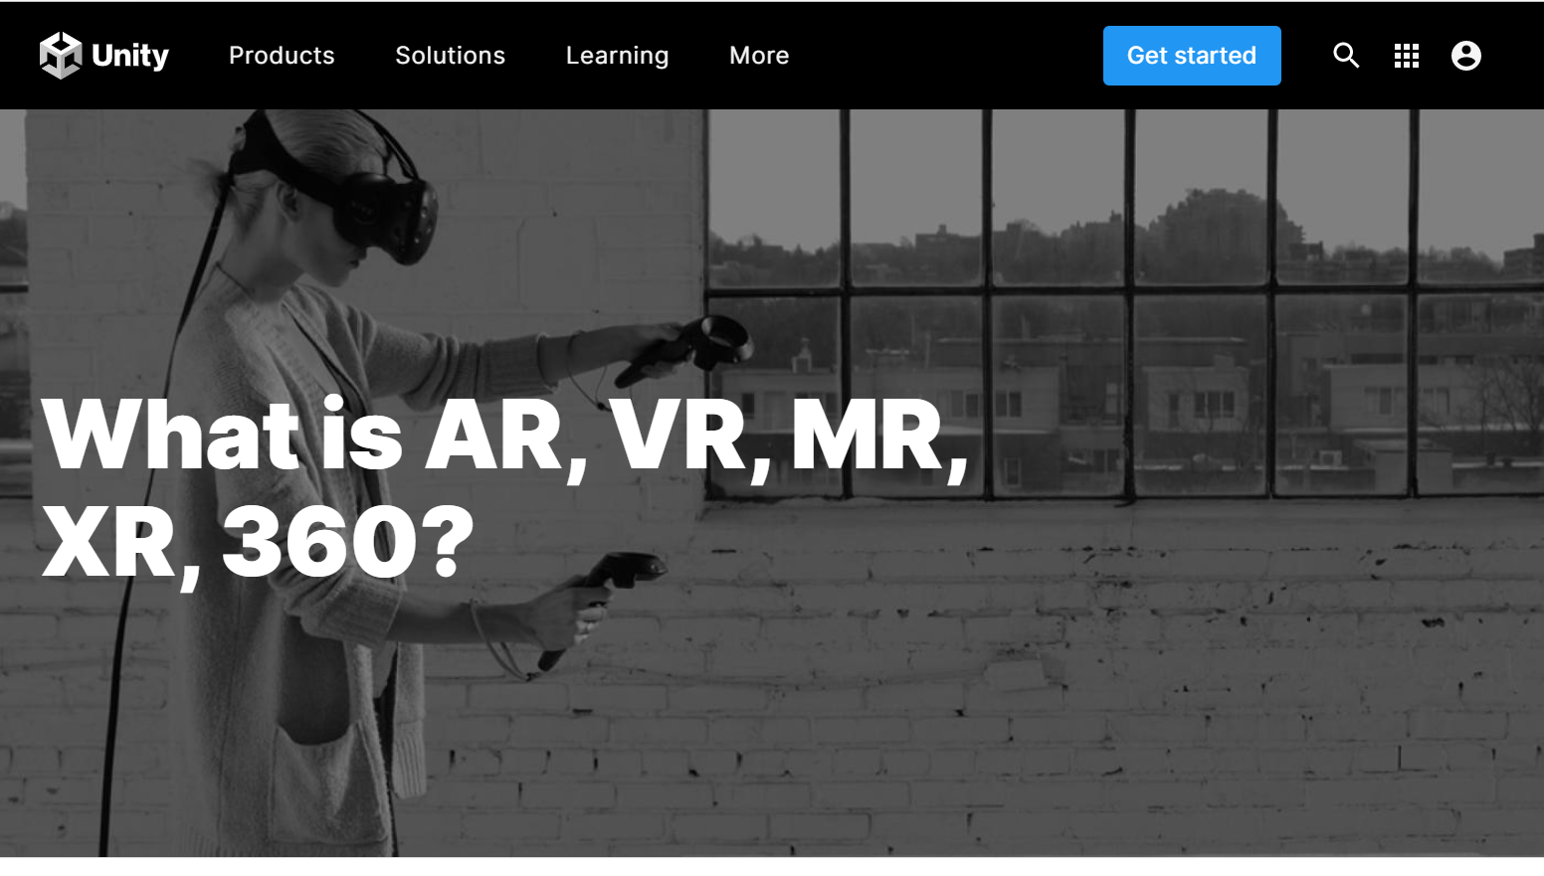
Glossary of XR-specific terms

Slide 22

Rendering for AR/VR
Single Pass Stereo rendering (Double-Wide rendering)
Normal VR rendering

Slide 23

Single-Pass Stereo VR rendering:

Slide 24
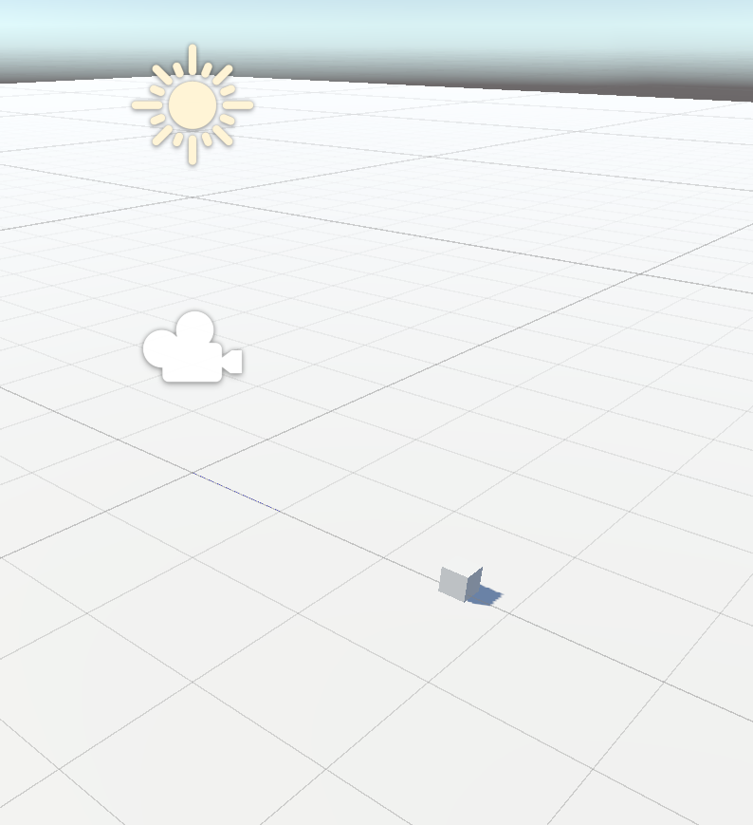
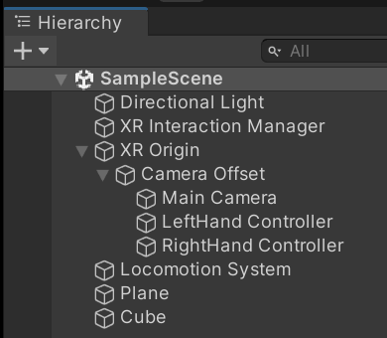
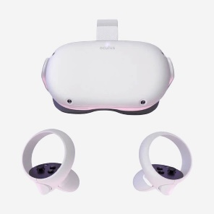
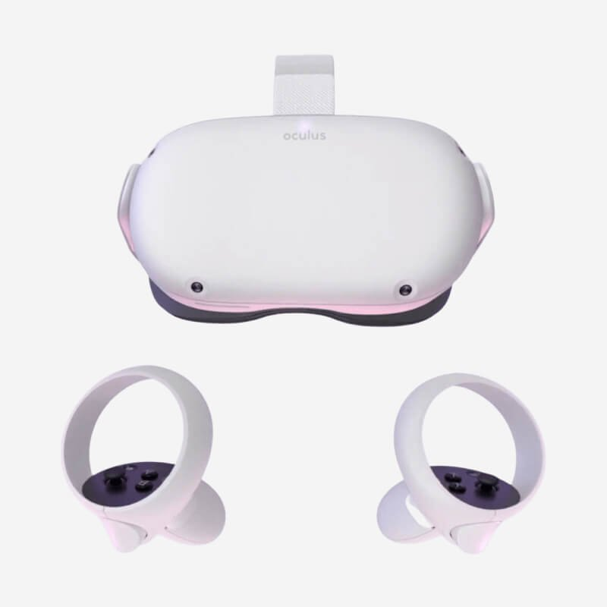

Slide 25
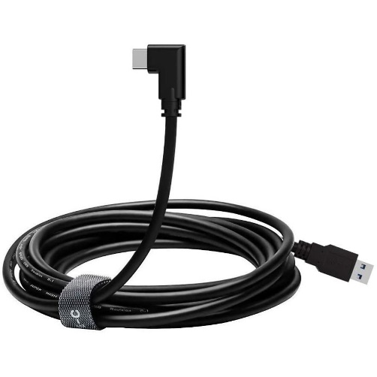

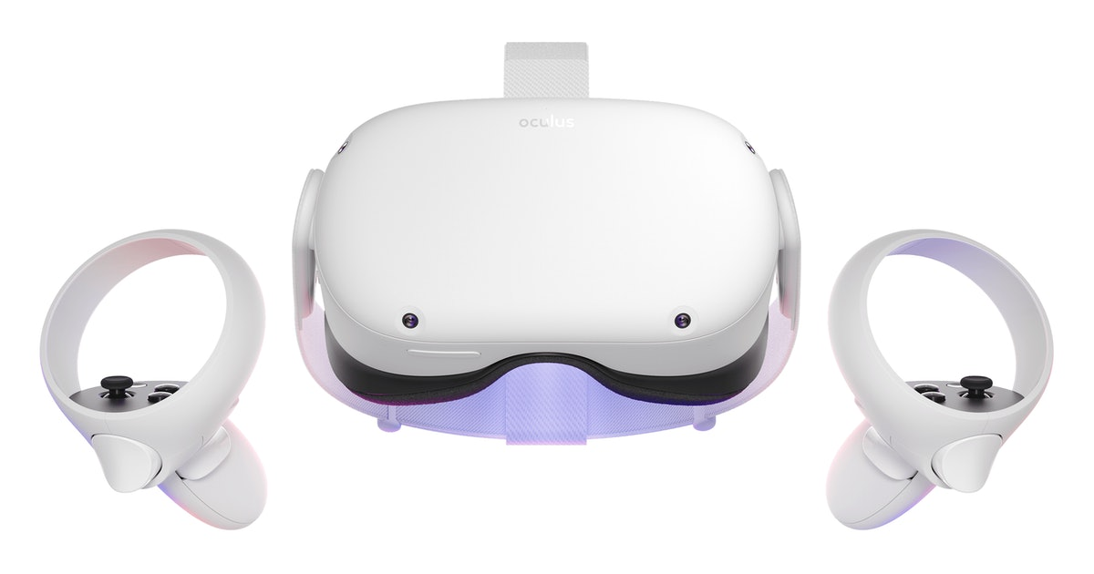
간단한 VR Game 만들기
전용 USB3.0
XR Plug-in Management
XRI (XR Interaction Manager)
XR Interaction Toolkit

Slide 26
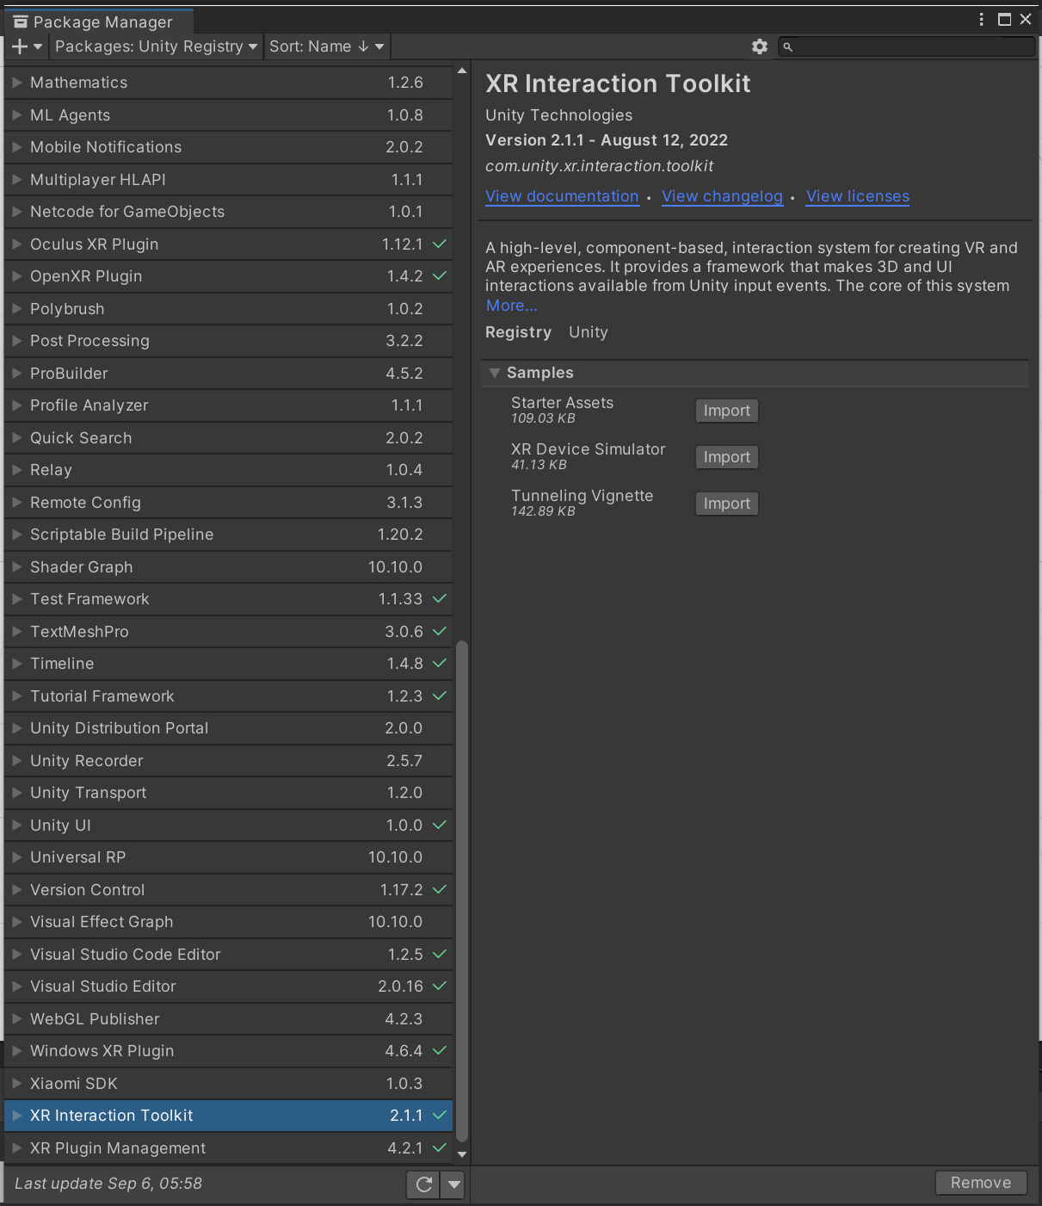
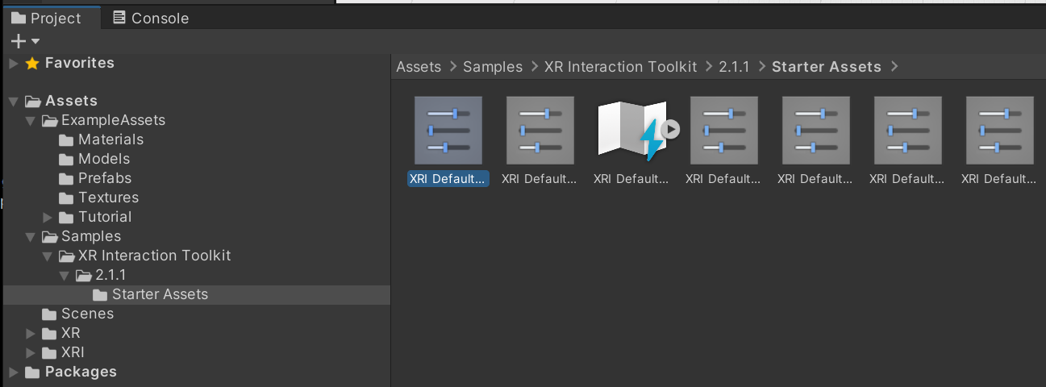

Slide 27
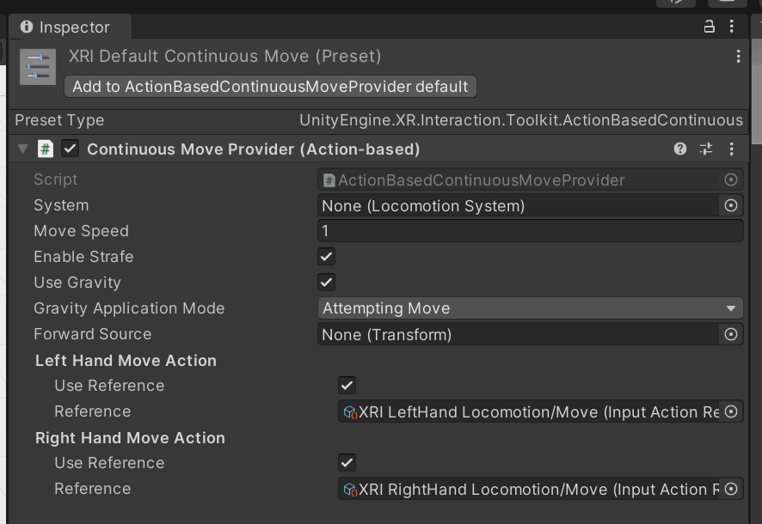

Slide 28
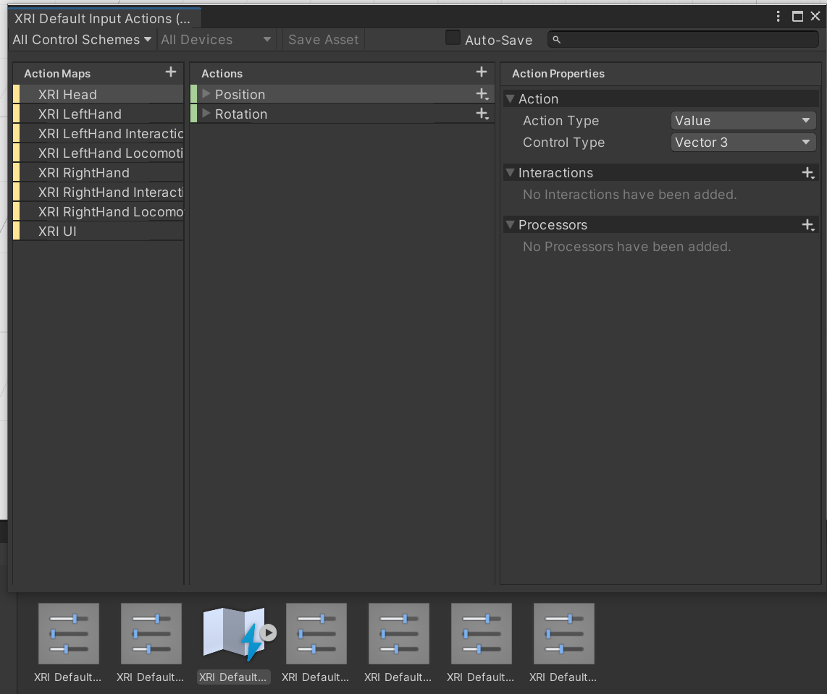

Slide 29
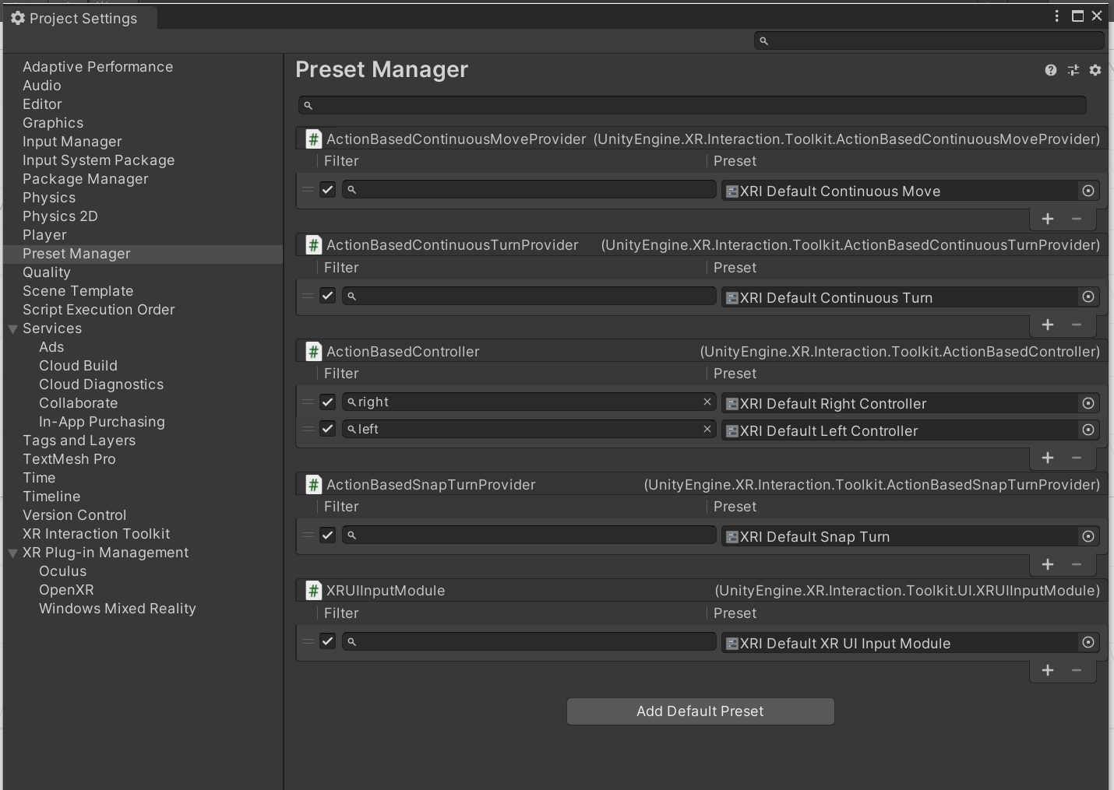

Slide 30
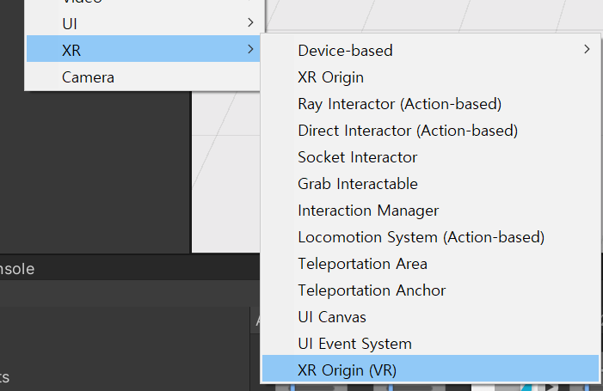
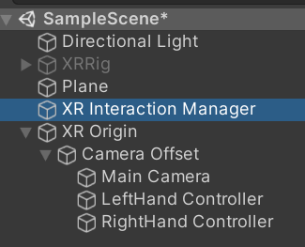
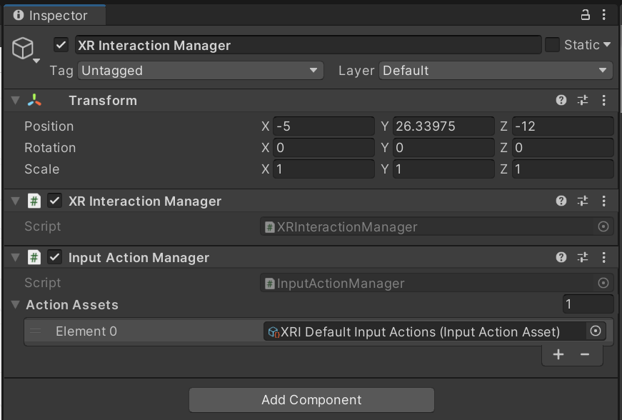

Slide 31
Getting started with VR development in Unity (Unity - Manual: Getting started with VR development in Unity (unity3d.com))
Unity supported platforms
Oculus: Oculus Plug-in
OpenXR: OpenXR Plug-in
Input and interactions
Unity’s XR Interaction Toolkit enables you to add interactivity to your VR applications, without having to code the interactions from scratch. You can download it via the Package Manager.

Slide 32
Oculus App Development in Unity (Oculus App Development in Unity | Oculus Developers)
Get Started - Describes the steps needed to start developing in Unity with Oculus. Set up your development environment, enable your device for development, import the Oculus integration package, configure settings, and build your first app.
Core Development Blocks - Develop with Unity Oculus Integration Package and implement the key components to an immersive VR experience. This includes overviews of the package components, camera rig, controllers, integrating a guardian, adding haptic feedback, and hand tracking.
Build Tools - Develop more effectively: optimize build iterations, strip unused shaders, and upload the app to the Oculus Store to reduce your iteration time.
Package Capabilities - Implement advanced features that optimize rendering for more realistic environments, maximize the field of view, integrate seamless system menus, and enhance immersion to create a more realistic experience.
Metrics - Improve performance and debug your app with Oculus metrics.
Additional Tools and SDKs - Create immersive audio experiences using the Audio SDK, use Meta Avatars to create modular avatars that can be used across mulitple devices, use Oculus Avatars to create co-present experiences in Oculus, or use the Oculus Platform SDK for immersive networking features.
Sample Framework - Learn more about Unity development with these sample scenes for developers for common VR-specific features including hand presence with Oculus Touch, locomotion, custom hands, and the Oculus Guardian System.
Best Practices - Optimize development using best practices in your development with performance targets and advice for the best results on Oculus headsets.
Scripting Reference - The Unity Scripting Reference documentation contains detailed information about the data structures and files included with the Oculus Integration unity package.
Cross-Platform Development - Develop apps that run across multiple VR platforms including Oculus and OpenVR.
Release Notes - Check out previous Oculus Unity Integration releases in the Release Notes archive.
Gear VR Development Guide - Legacy - A legacy guide for the deprecated Gear VR headset.

Slide 33
OpenXR Plugin(OpenXR Plugin | OpenXR Plugin | 1.5.1 (unity3d.com))
Runtime | Build target | Preferred Graphics API | Feature Parity | Known Limitations
Windows Mixed Reality | Windows 64-bit | DX11 | Full feature parity via Mixed Reality OpenXR Plugin for Unity
HoloLens 2 | UWP arm64 | DX11 | Full feature parity via Mixed Reality OpenXR Plugin for Unity
Oculus PC + Link | Windows 64-bit | DX11 | HMD + Controllers | Oculus Integration package features not available
Oculus Quest | Android arm64 | Vulkan | HMD + Controllers via Oculus Quest Support Feature | Oculus Integration package features not available Not yet recommended for production.
All other conformant runtimes (eg. SteamVR) | Windows 64-bit | DX11 | HMD + Controllers | Given the unbounded combinations of possible hardware/software configurations, Unity is unable to test or guarantee that all configurations will work optimally. SteamVR Plugin features not available
Requirements
2020 LTS+
Runtimes

Slide 34
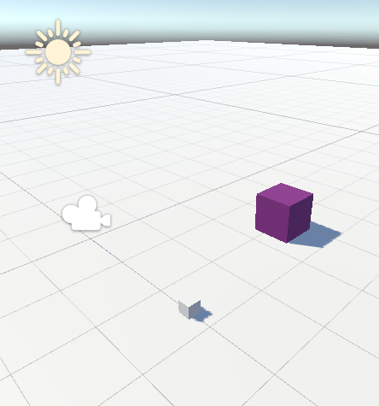
블럭쌓기 게임
실행동영상(https://injeackr.sharepoint.com/:v:/s/222ASB133101_/EQEyGHJkC3ZDi5X9ht3GScQBGvdWlpcDpnZBusaUNGw1hg?e=GmOEJL)
선택하면 임의의 색을
가진 상자가 만들어진다
GenerateBox:XRBaseInteractable
게임 내용
1.보라색 상자를 잡으면(Grab) 임의색을 갖는 작은 상자가 생성된다.
2.생성된 상자를 잡아서(Grab) 옮겨서 쌓는다.
생성된 상자를 옮겨서 이 곳에 쌓는다.
XR Grab Interacable

Slide 35
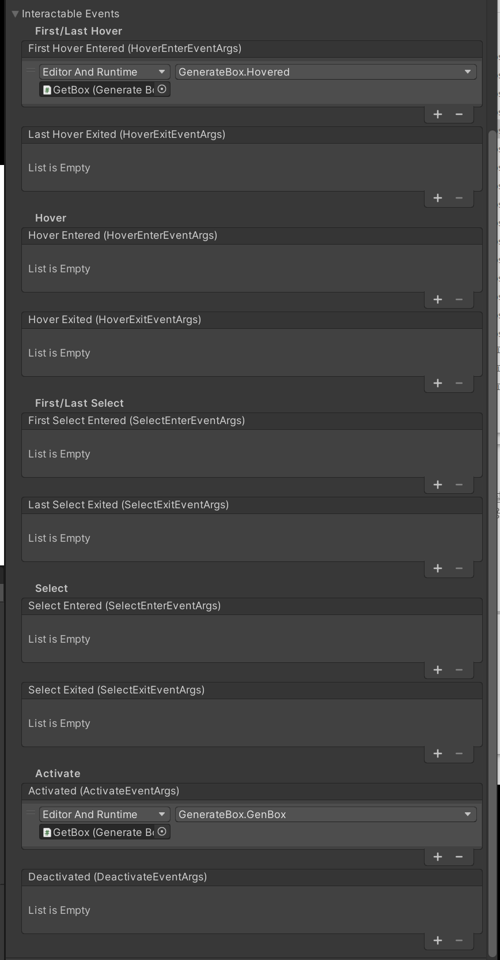
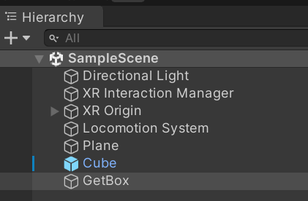
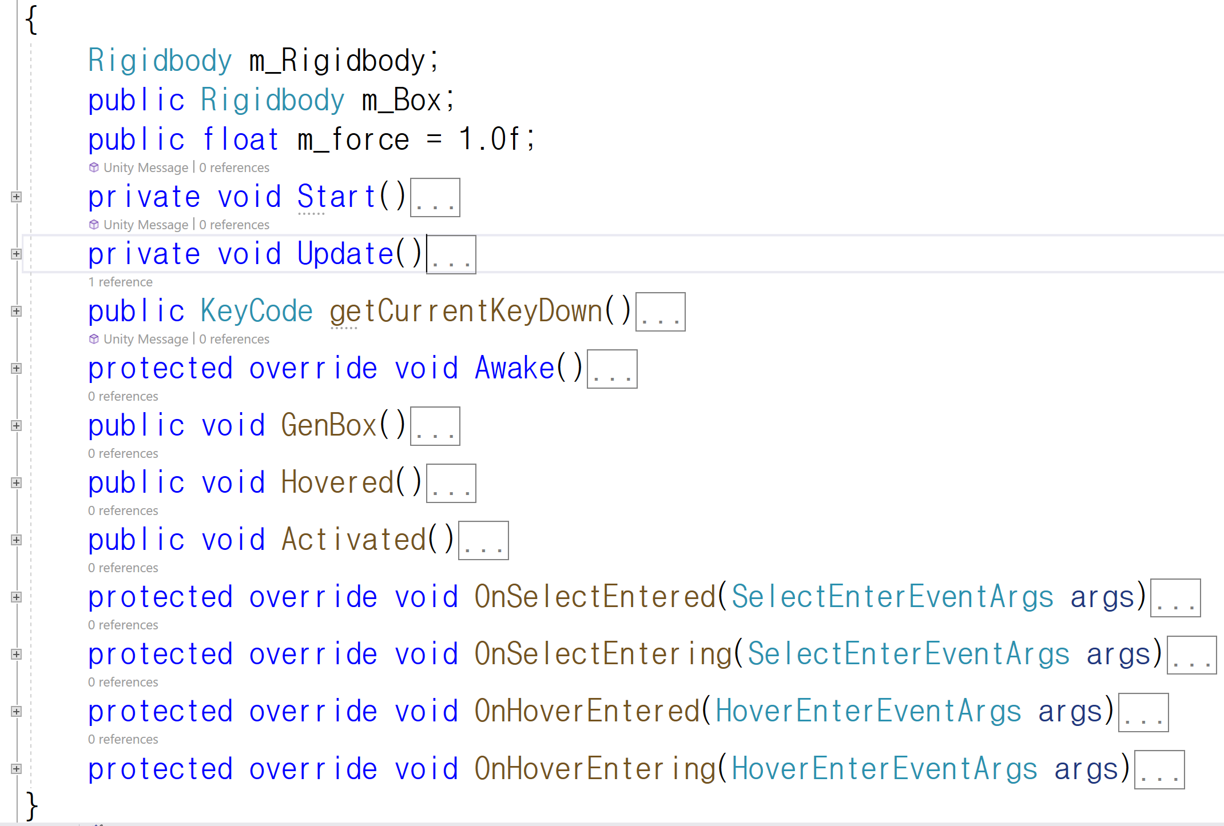
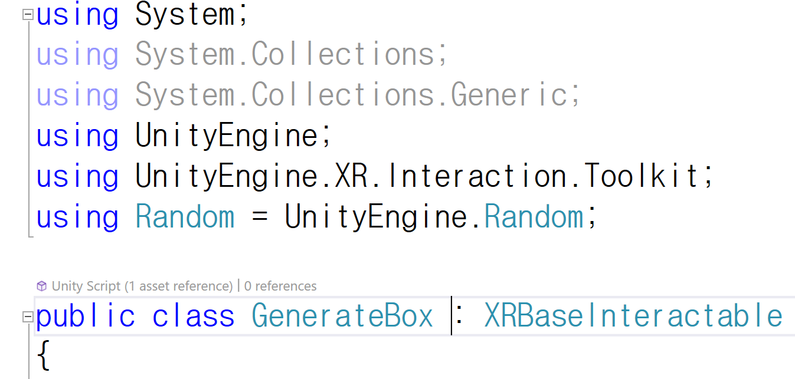
Event Handler 추가

Slide 36
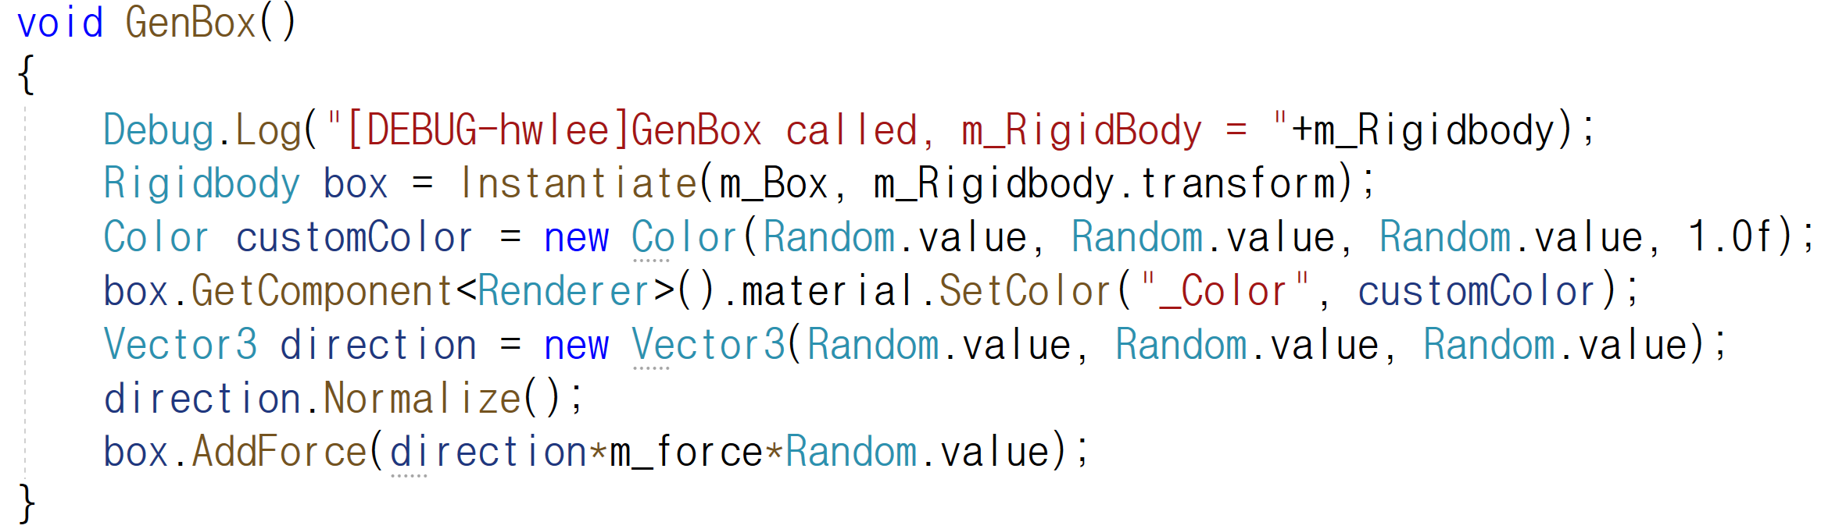
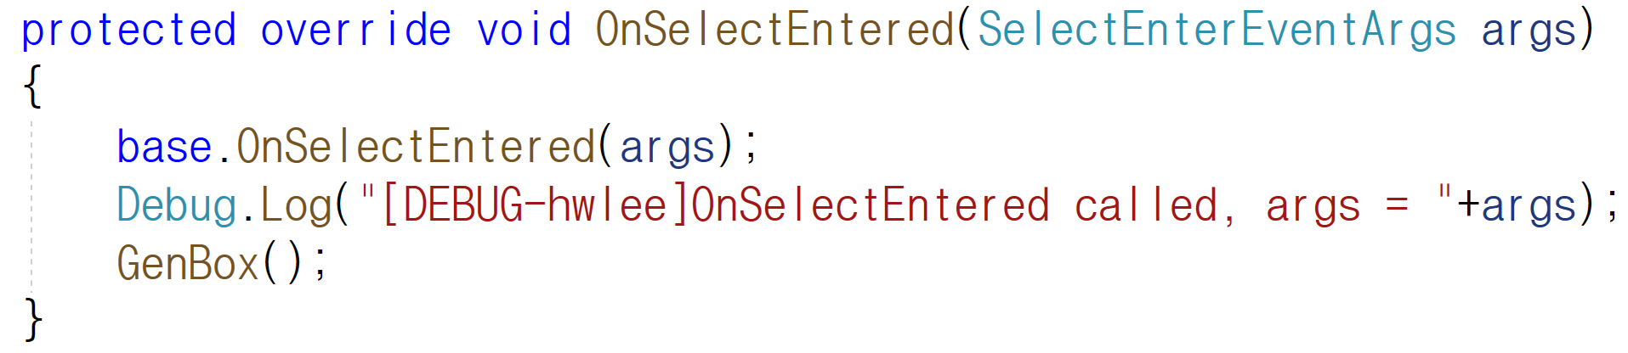
GenerateBox.cs
XRBaseInteractable
GenerateBox
OnSelectEntered
GenBox

Slide 37
XR Plug-in Management
XR Interaction Toolkit and Samples
Tracking Origin Mode : Floor
6 DoF(degree of freedom) : translation and rotation
Oculus Quest2, Vive, Index, etc.
Tracking Origin Mode : Not specified
3 DoF : rotation only
Gear VR, Oculus Go, Google Cardboard

Slide 38
Tracking Origin Mode(Unity - Scripting API: TrackingOriginMode (unity3d.com))
Device | Represents a Device relative tracking origin. A Device relative tracking origin defines a Local Origin at the position of the device in space at some previous point in time, usually at a recenter event, power-on or AR/VR session start. Pose data provided by the device will be in this space relative to the local origin. This means that poses returned in this mode will not include the user height (for VR) or the device height (for AR) and any camera tracking from the XR Device will need to be manually offset accordingly.
Floor | Represents the tracking origin whereby 0,0,0 is on the "floor" or other surface determined by the XR Device being used. The pose values reported by an XR Device in this mode will include the height of the XR Device above this surface, removing the need to offset the position of the camera tracking the XR Device by the height of the user (VR) or the height of the device above the floor (AR).
Unknown | This indicates that the device does not know, or is unable to determine how it is reporting pose data. This value should be treated as an error condition.

Slide 39
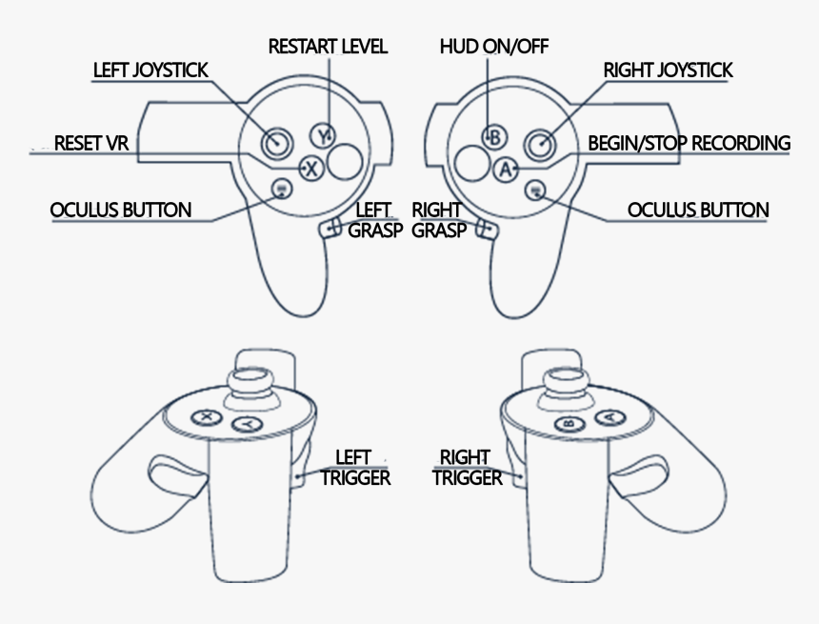
Joystick1Button3
Joystick2Button11
Joystick1Button16
Joystick2Button10
Joystick1Button13
Joystick2Button17
Touch = Hover
Grab = Select
Trigger = Activate
Joystick1Button4
Joystick2Button15
Joystick1Button14
Joystick2Button5

Slide 40
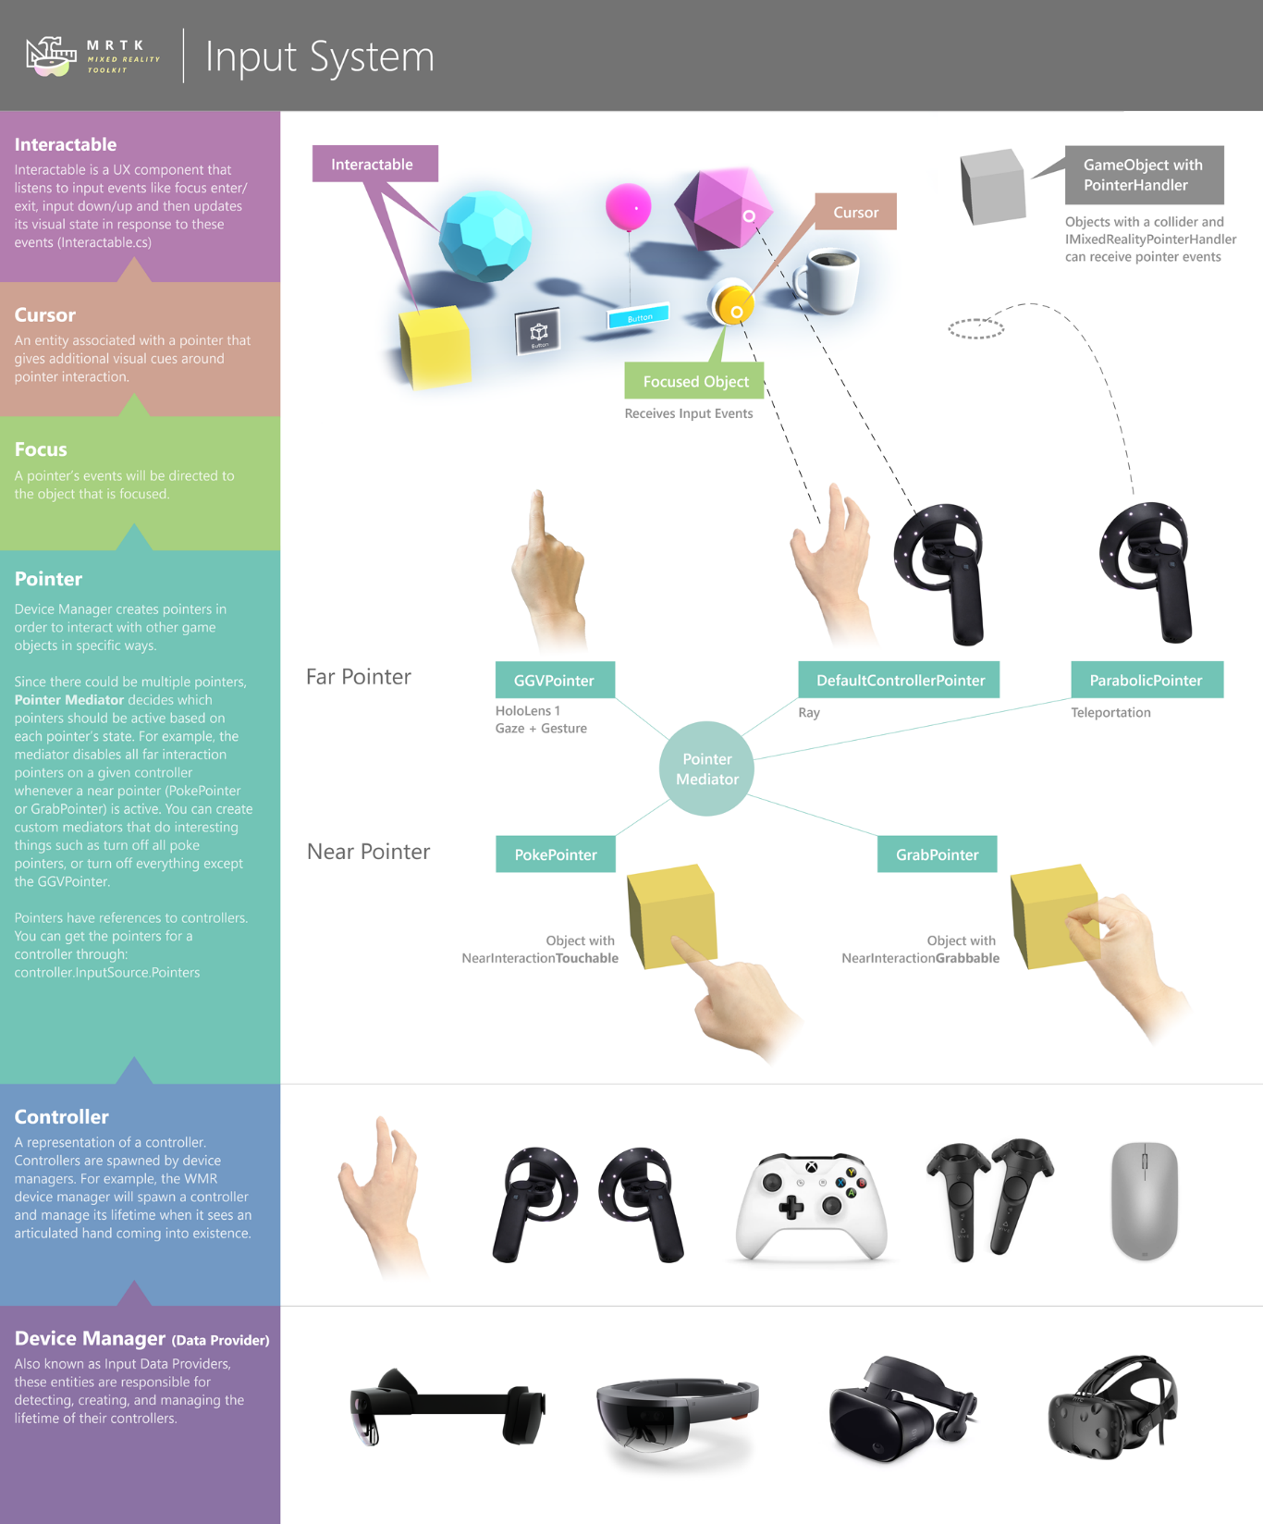
Controller
Interactor
Interactable

Slide 41
Locomotion System
Teleportation Provider
Teleport Area/Ancher

Slide 42
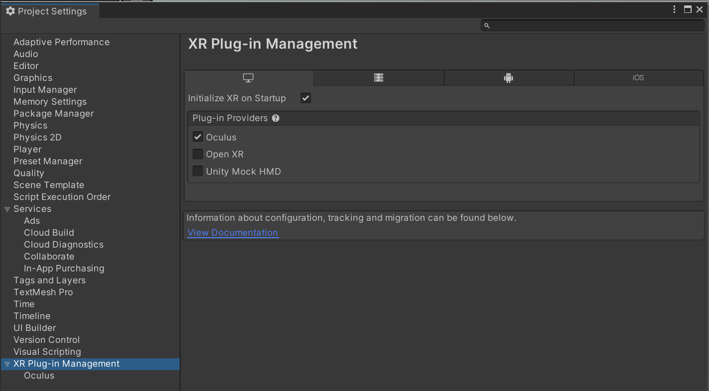
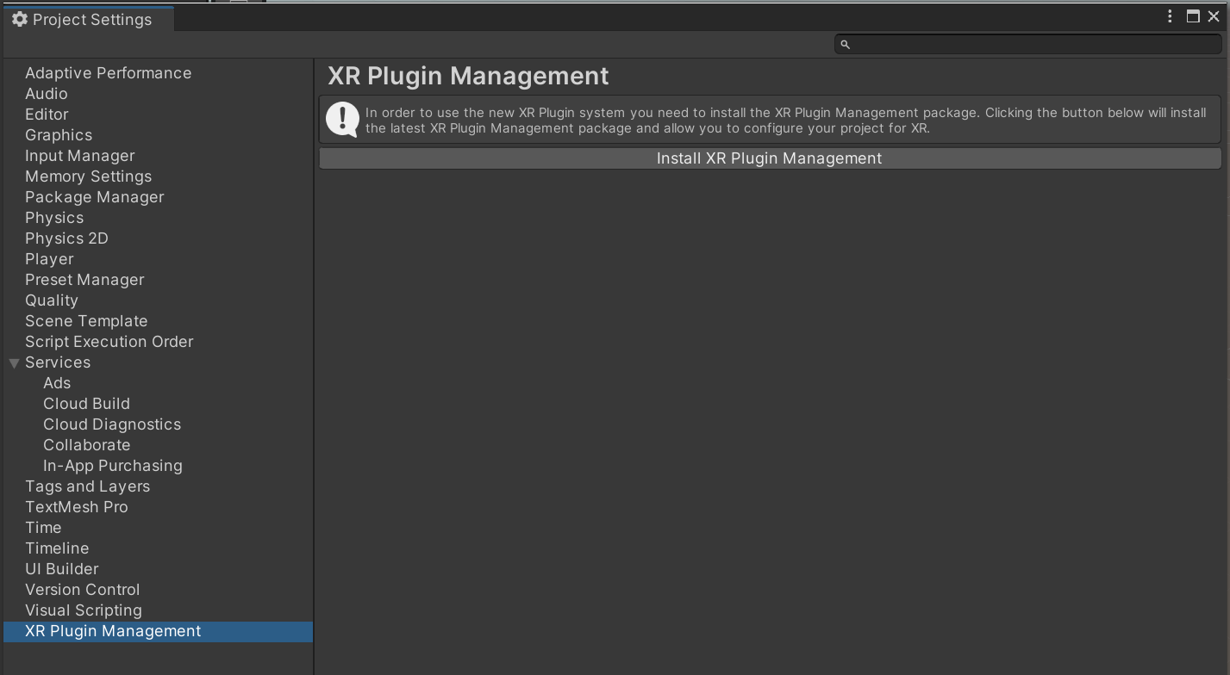
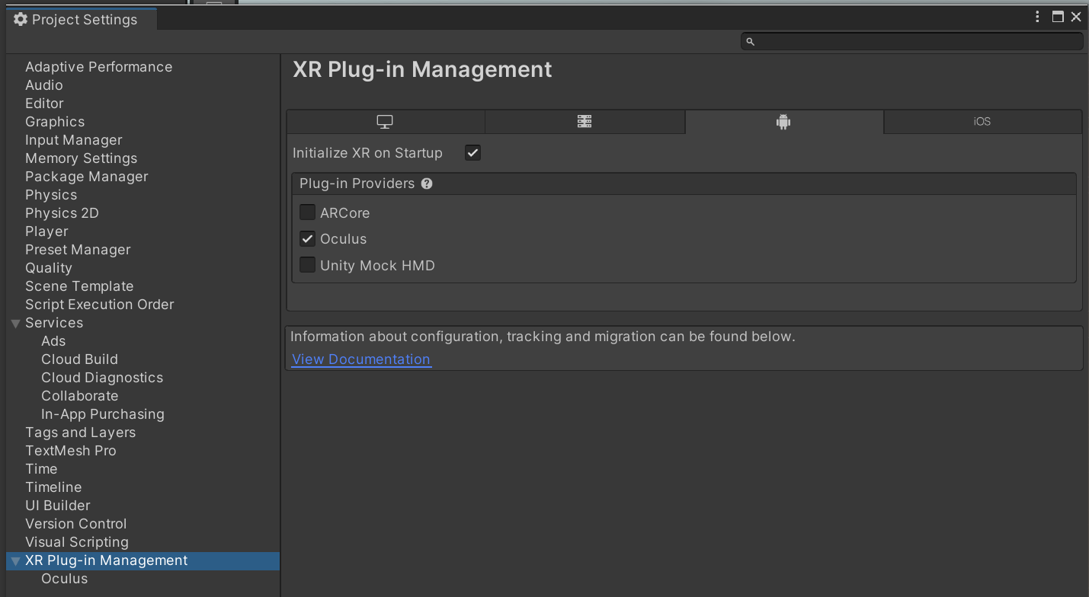
게임 만들기 순서
3D 게임 생성 (Block01)
XR Plugin Management 설치
Stereo Rendering Mode -> Multi Pass 로 설정
PC Version
Android

Slide 43
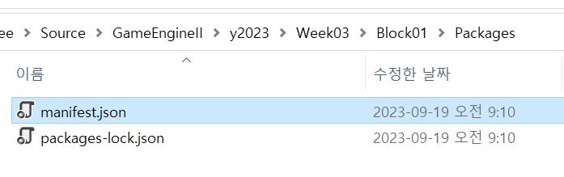
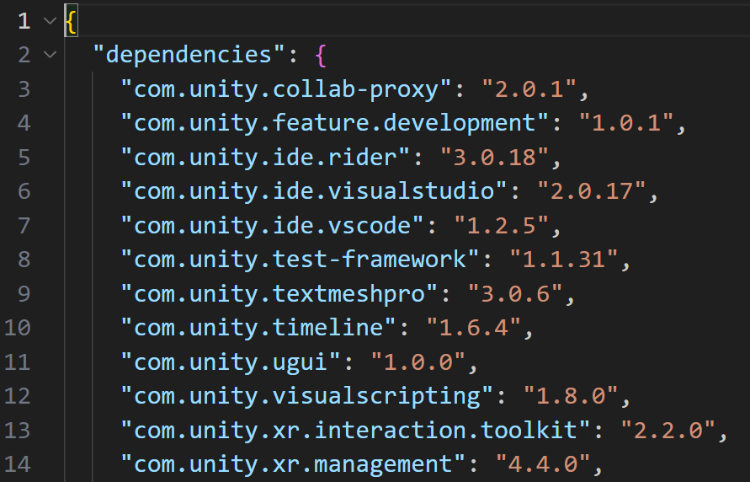
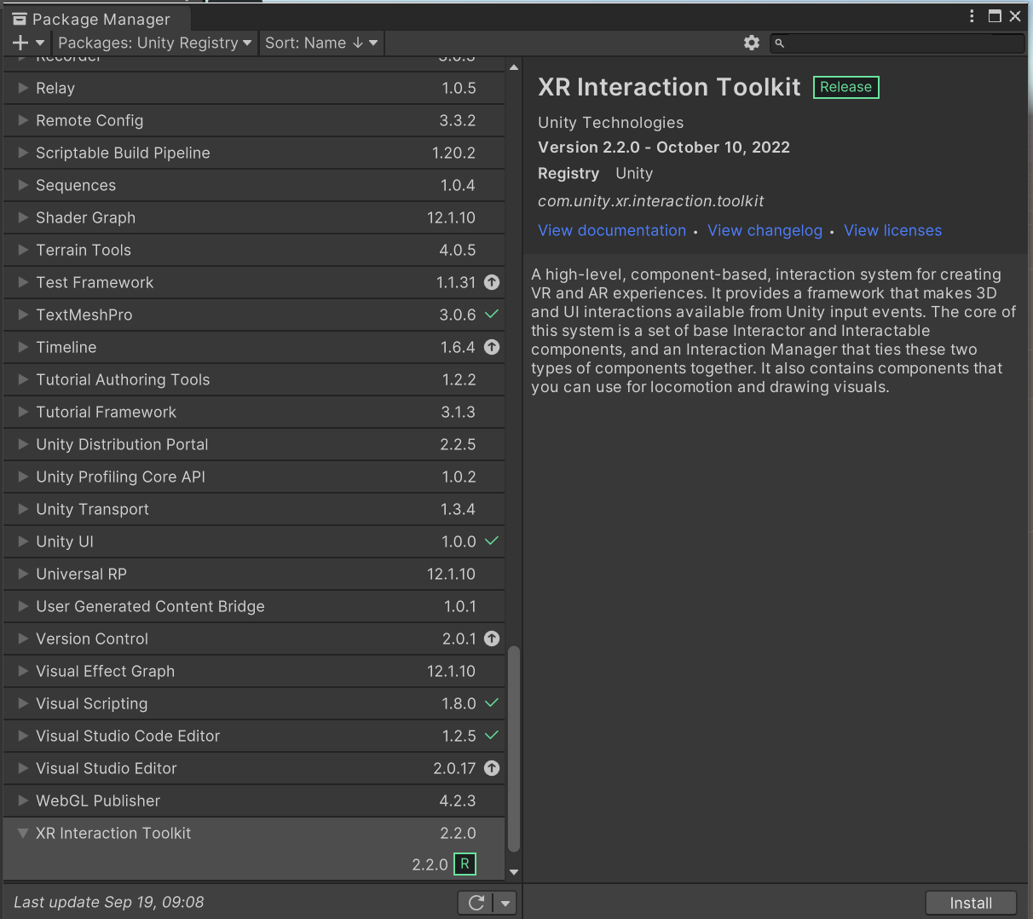
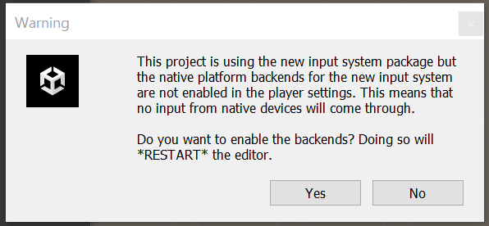
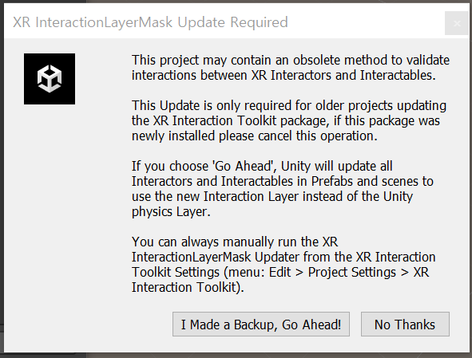
게임 만들기 순서
XR Interaction Toolkit 설치

Slide 44
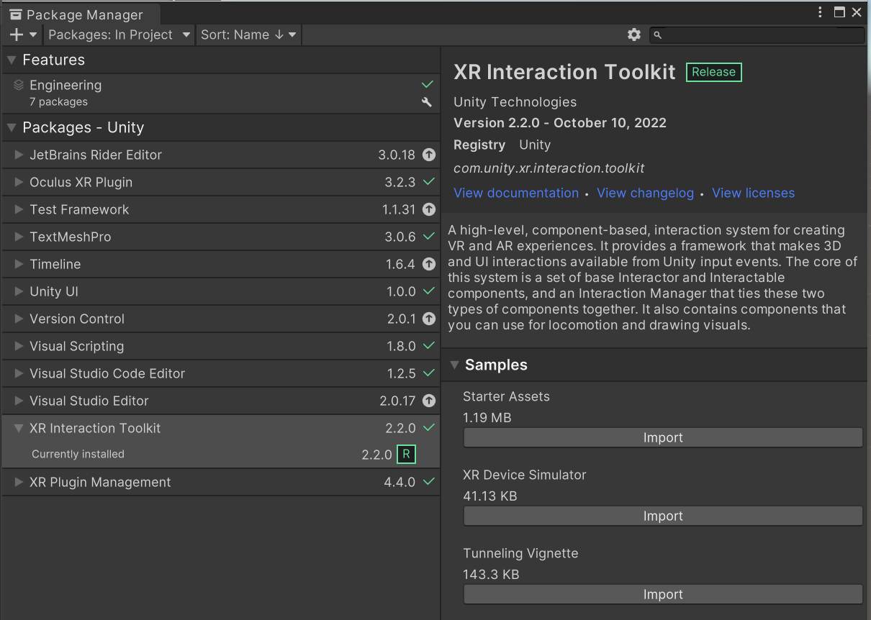
게임 만들기 순서
Starter Asset 설치

Slide 45
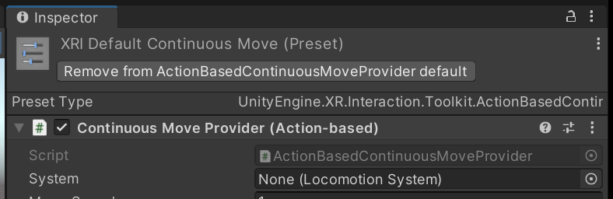
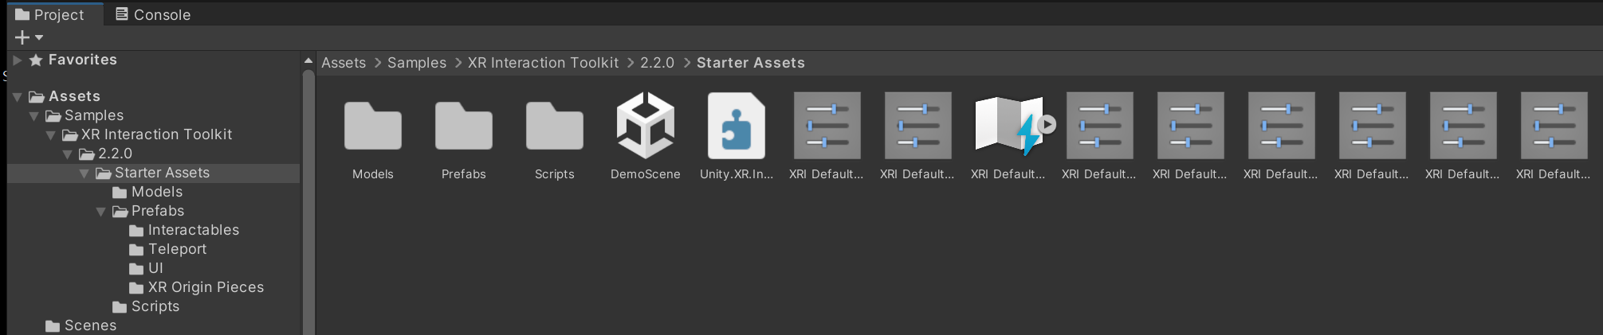
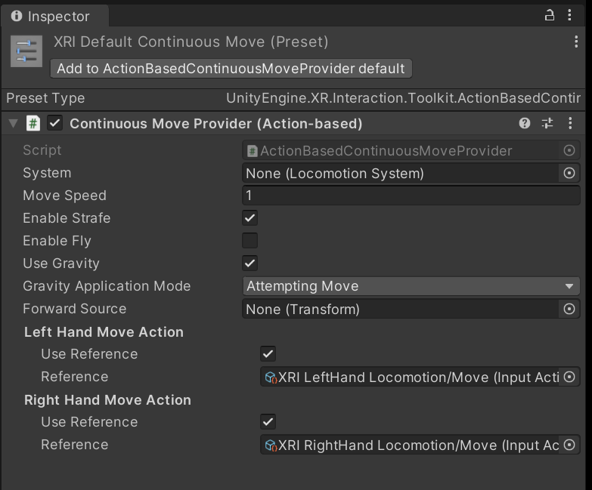
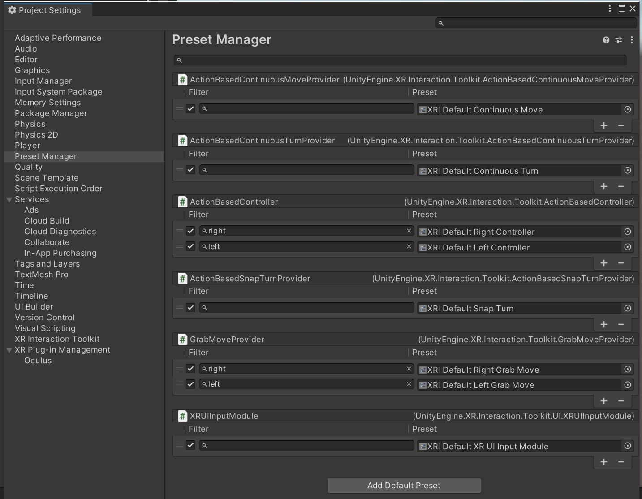
게임 만들기 순서
XR Default Continous Move 추가
XR Default Continuous Move
모든 XR Default 에 대하여 추가

Slide 46
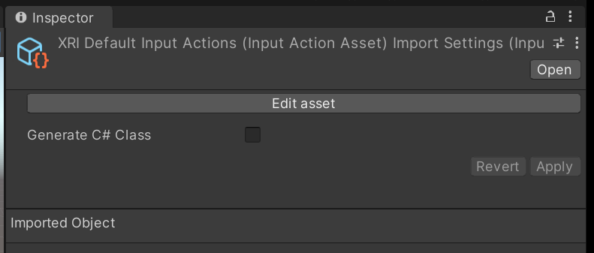

Slide 47
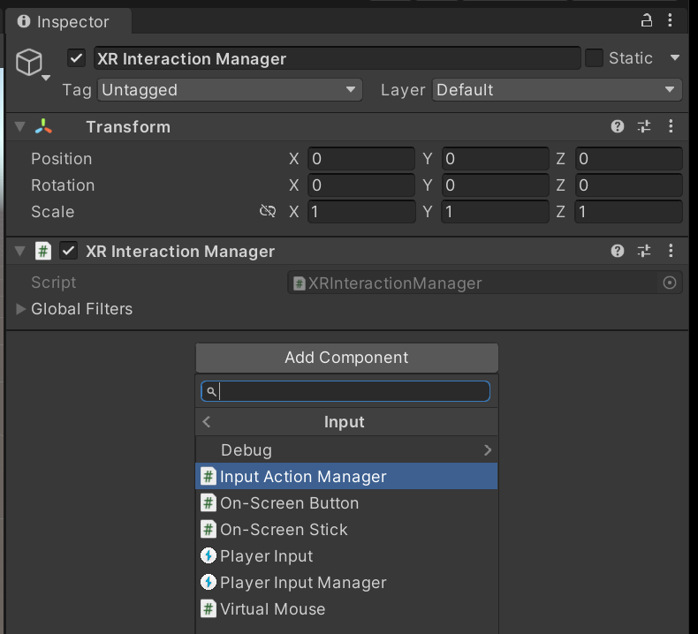
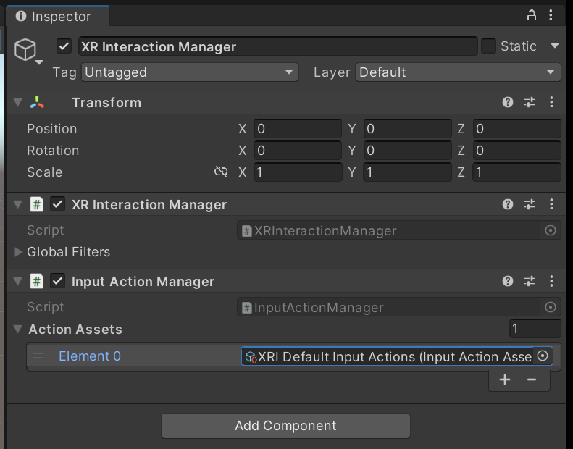
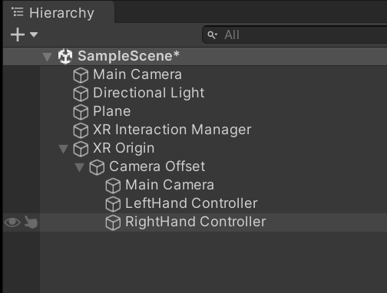
게임 만들기 순서
Plane, XR Origin(VR) 등 추가

Slide 48
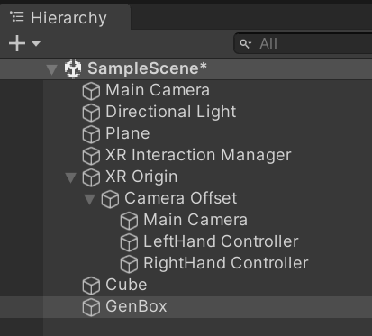



게임 만들기 순서
Cube는 size를 0.2로
Cube와 GenBox를 적당한 위치로 이동
Cube, GenBox 추가
XR Origin Main Camera
SampleScene Main Camera

Slide 49


게임 만들기 순서
Cube를 Prefab으로 만들기
Cube에 RigidBody 추가

Slide 50

스크립트 편집 툴 설정
Microsoft Visual Studio Community

Slide 51


게임 만들기 순서
GenBox 스크립트 작성
GameEngine2/y2023/Week03/Block01/GenerateBox.cs at main · ijhwlee/GameEngine2 (github.com)
GenBox 객체에 GenerateBox 스크립트 적용 후
Box 에 Cube Prefab 적용
Interactable Events에 해당하는 함수 적용

Slide 52
Event Handler 추가

Slide 53

게임 만들기 순서
Android 빌드 설정

Slide 54
할일
블럭쌓기 게임을 완성하시오.

